Slide 1






Product Teardown
New User Onboarding
By Amisha Kumari

Slide 2




Overview
Overview User Persona User Journey Product Improvement
Metrics
what is DUNZO???
Dunzo is an Indian hyperlocal delivery platform that offers on-demand delivery services for a wide range of essentials, including fruits, vegetables, meat, pet supplies, food, and medicines, in major cities like Bengaluru, Pune, and Delhi.
Additionally, Dunzo provides a unique service to pick up and deliver packages within the same city.
Revenue Model
The company generates revenue primarily through:
Delivery Fees Commissions Surge Pricing Premium Services
Founded : 2014
Category: Online consumer Services
App Download: 5,000,000+
Competitors

Slide 3
Product Improvement
Overview
User Persona
User Journey
Metrics
Goals:
Get access to a variety of products without having to leave her home.
Receive fresh, high-quality groceries at her doorstep quickly and effortlessly.
Save time by avoiding daily trips to the store.
Ensure that essential items are never forgotten by setting up an easy ordering system.
Pain Points:
Often forgets to buy essential items due to her busy schedule.
Finds it tiring to visit stores daily or on weekends for grocery shopping.
Sometimes, stores don't have all the items she needs, forcing her to visit multiple places.
Name: Ankita
Age: 30
Occupation: Analyst
Location: Bangalore
Lifestyle: Ankita is a busy professional with a full-time job, managing both work and home life while living with her family.

Slide 4
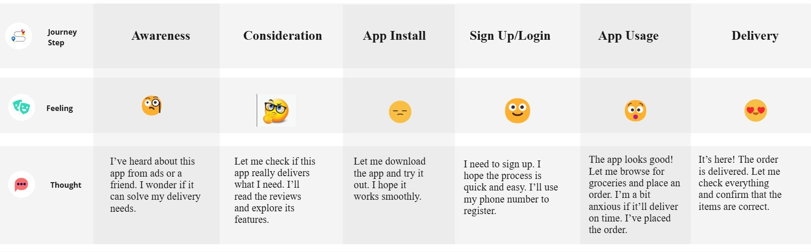
Product Improvement
Overview
User Persona
User Journey
Metrics
User Journey

Slide 5
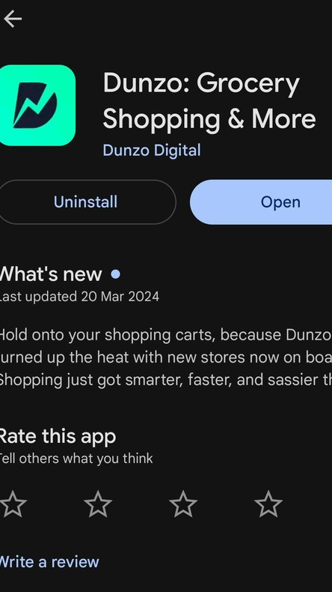
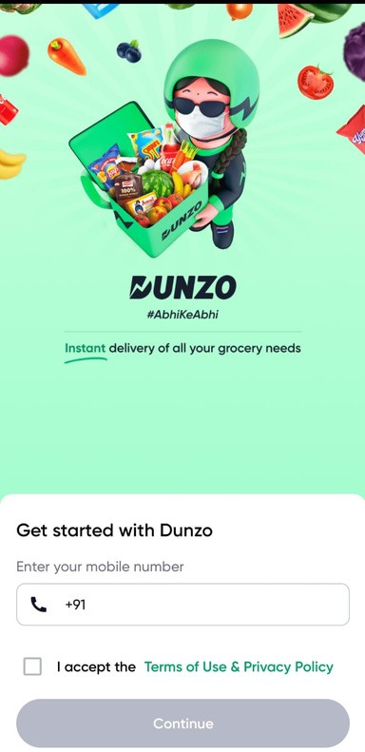
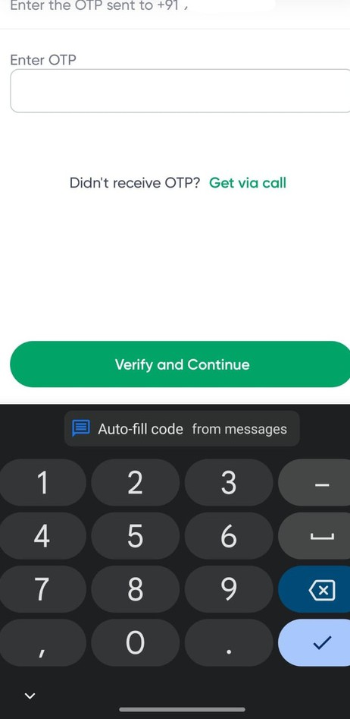
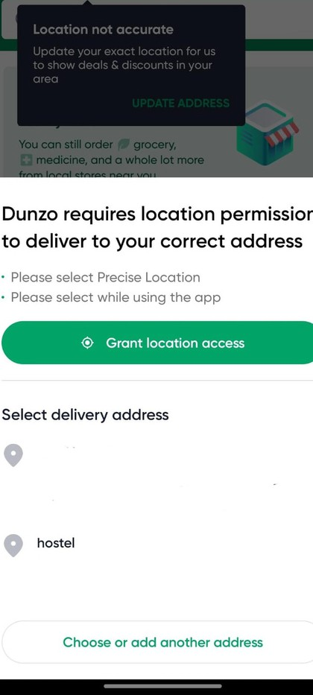
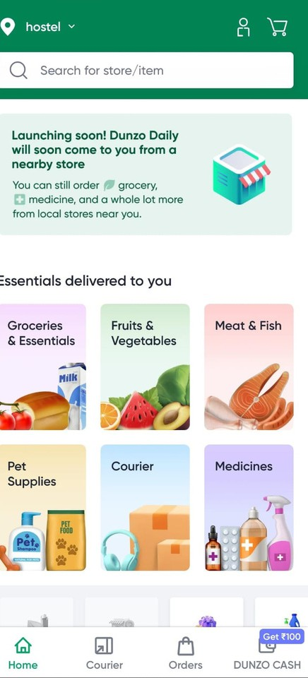
Overview
User Persona
User Journey
Product Improvement
Metrics
User Journey Phase 1
Onboarding
64/2, 2nd Temple Street, Vyalikaval, Kodandarampura, Malleshwaram,
Step1 : Download Dunzo from PlayStore
Step2 : Enter Phone Number
Step3 : Enter OTP
Step4 : Click on Grant Location Access
Step5 : Home Page

Slide 6
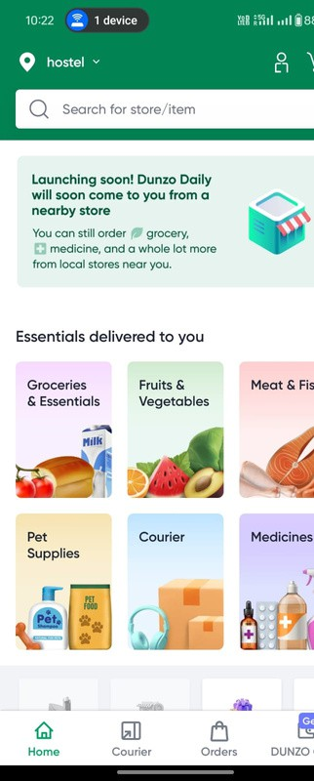
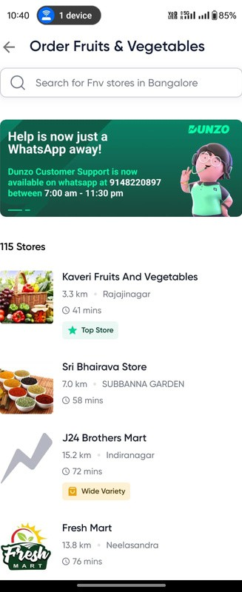
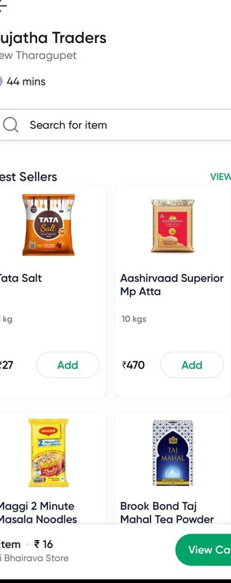
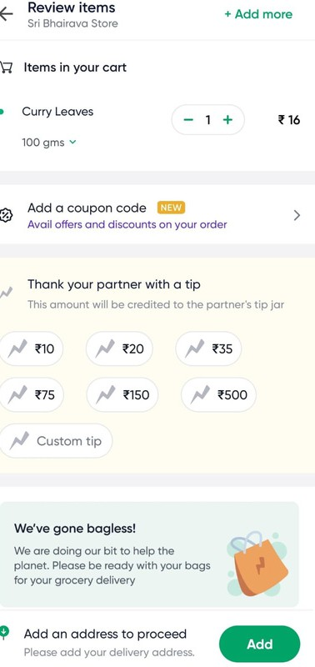
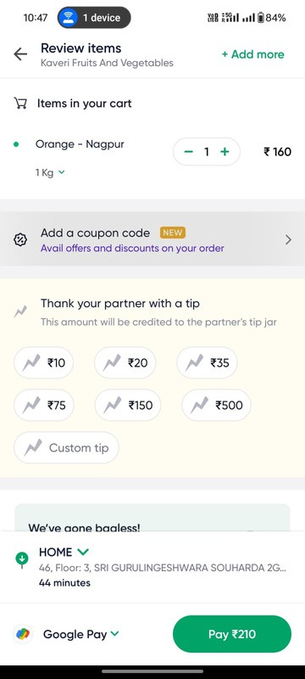
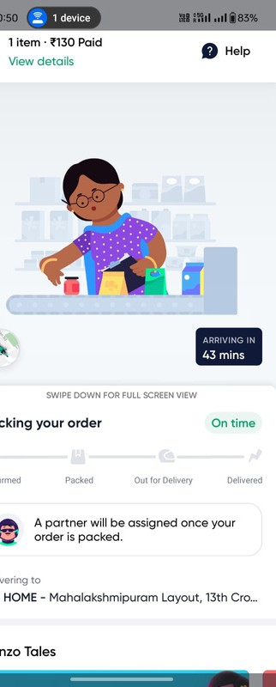

Overview
User Persona
User Journey
Product Improvement
Metrics
User Journey Phase 1
Placing the order
Step6 : Select the Category
Step7 : Select the Store
Step8 : Select the Item
Step9 : Add address
Step10 : Payment Page
Step11 : Order tracking Page

Slide 7
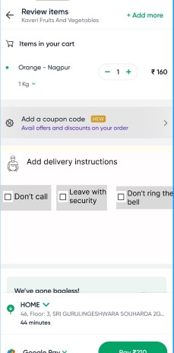
Overview User Persona User Journey Product Improvement Metrics
Out-of-Stock Notification Feature:
Current Situation: When an item is out of stock on the Dunzo app, there is no way to keep track of its restock or receive notifications for its availability.
Recommendation: Dunzo should introduce a feature that allows users to enable notifications for when out-of-stock items are restocked.
Improved Partner Assignment Speed:
Current Situation: Delivery partner assignments sometimes take longer than expected, leading to delays and slower service.
Recommendation: Dunzo should optimize the partner assignment system to improve delivery partner allocation speed.
Delivery Instructions Feature:
Current Situation: There is no structured way to communicate specific delivery instructions (e.g., don’t ring the bell , give to the guard, etc.).
Recommendation: Implement a delivery instructions feature where users can specify preferences for how the order should be delivered.

Slide 8
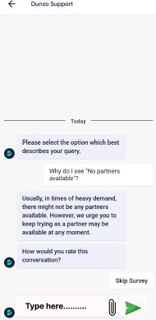
Product Improvement
Overview
User Persona User Journey
Metrics
Faster Delivery (Within 10 Minutes):
Current Situation: Although Dunzo is known for fast deliveries, it doesn’t always meet the 10-minute delivery goal seen with competitors.
Recommendation: Dunzo should aim for 10-minute delivery windows in select areas, especially in high- density, high-demand locations.
Allow Users to Add Custom Notes for Support Queries:
Current Situation: Dunzo customer support currently does not allow users to type specific instructions or custom queries directly within the app.
Recommendation: Introduce a feature where users can write detailed messages or notes about their issue or delivery concern when contacting support.

Slide 9

Product Improvement
Overview
User Persona User Journey
Metrics
Tracking Key Metrics for Dunzo Growth
L1 Metrics :
Active Users : Tracks the number of unique users interacting with the app over a specific period (daily, weekly, or monthly).
Customer Retention Rate : Percentage of users who continue to use the app after their first interaction
over a defined period.
Order Frequency : Measures the average number of orders placed by a user over a given time period.
Revenue Growth Rate: Tracks the percentage increase in revenue over a specific time period.
L2 Metrics:
Cart Abandonment Rate : Measures the percentage of users who add items to their cart but do not complete the purchase.
Order Accuracy Rate : Percentage of orders that are delivered correctly.
Push Notification Engagement Rate : Measures how many users interact with the push notifications they receive.

Slide 10
Product Improvement
Overview
User Persona
User Journey
Metrics
Customer Support Response Time : Measures the average time it takes for customer support to respond to user queries or issues.
North Star Metrics :
Total Orders per Month : Total number of orders placed by all users within a given month.
Time to Delivery : The average time it takes for an order to be delivered after it is placed.
Net Promoter Score (NPS) : A score that gauges customer satisfaction and how likely users are to recommend the service to others.
Customer Lifetime Value (CLTV) : The predicted net profit generated from a customer over the
entire duration of their relationship with the company.

Slide 11
THANK YOU
Amisha Kumari

